Slide 1
The Equity Framework
March 28, 2019

Slide 2
Vision Statement
Equity Strategic Framework
The Massachusetts Board of Higher Education aims to sustain and expand on Massachusetts’ unique leadership position in higher education as defined by the strength and reputation of our private and public postsecondary institutions and our nation-leading level of attainment among our adult citizens.
To further realize those goals and to ensure that public higher education opens doors of opportunity and fulfilment for traditionally underserved populations…
We elect to make our top statewide policy and performance priority:
Significantly raise the enrollment, attainment and long-term success outcomes among
under-represented student populations.
We intend this equity lens priority to guide campus and system performance measurement and promote initiatives and policies that collectively expand success for residents and for our economy and society.

Slide 3
Background: BHE Retreat – September 2018
Retreat Goals:
Build consensus on an approach to goal- setting
Build consensus on the schedule for goal-setting
Learn about similar efforts in other states
Learn about current higher education landscape in Massachusetts

Slide 4
Why a Top-Level Goal?
Increase focus on a single systemwide (statewide) priority can improve outcomes
Prioritize systemwide policies and initiatives that align with highest level goal to produce better results for students
Align campus priorities with systemwide goal to have greater impact and increase accountability

Slide 5
President Obama: 2020 College Completion Goal
“America cannot lead in the 21st century unless we have the best educated, most competitive workforce in the world.”
President Barack Obama
Remarks on Higher Education
April 24, 2009
“By 2020, America will once again have the highest proportion of college graduates in the world... So tonight I ask every American to commit to at least one year or more of higher education or career training... every American will need to get more than a high school diploma.”
President Barack Obama
Address to Joint Session of Congress
February 24, 2009

Slide 6



60%
60%
of adults with high quality degrees or credentials by the year 2025
www.luminafoundation.org

Slide 7
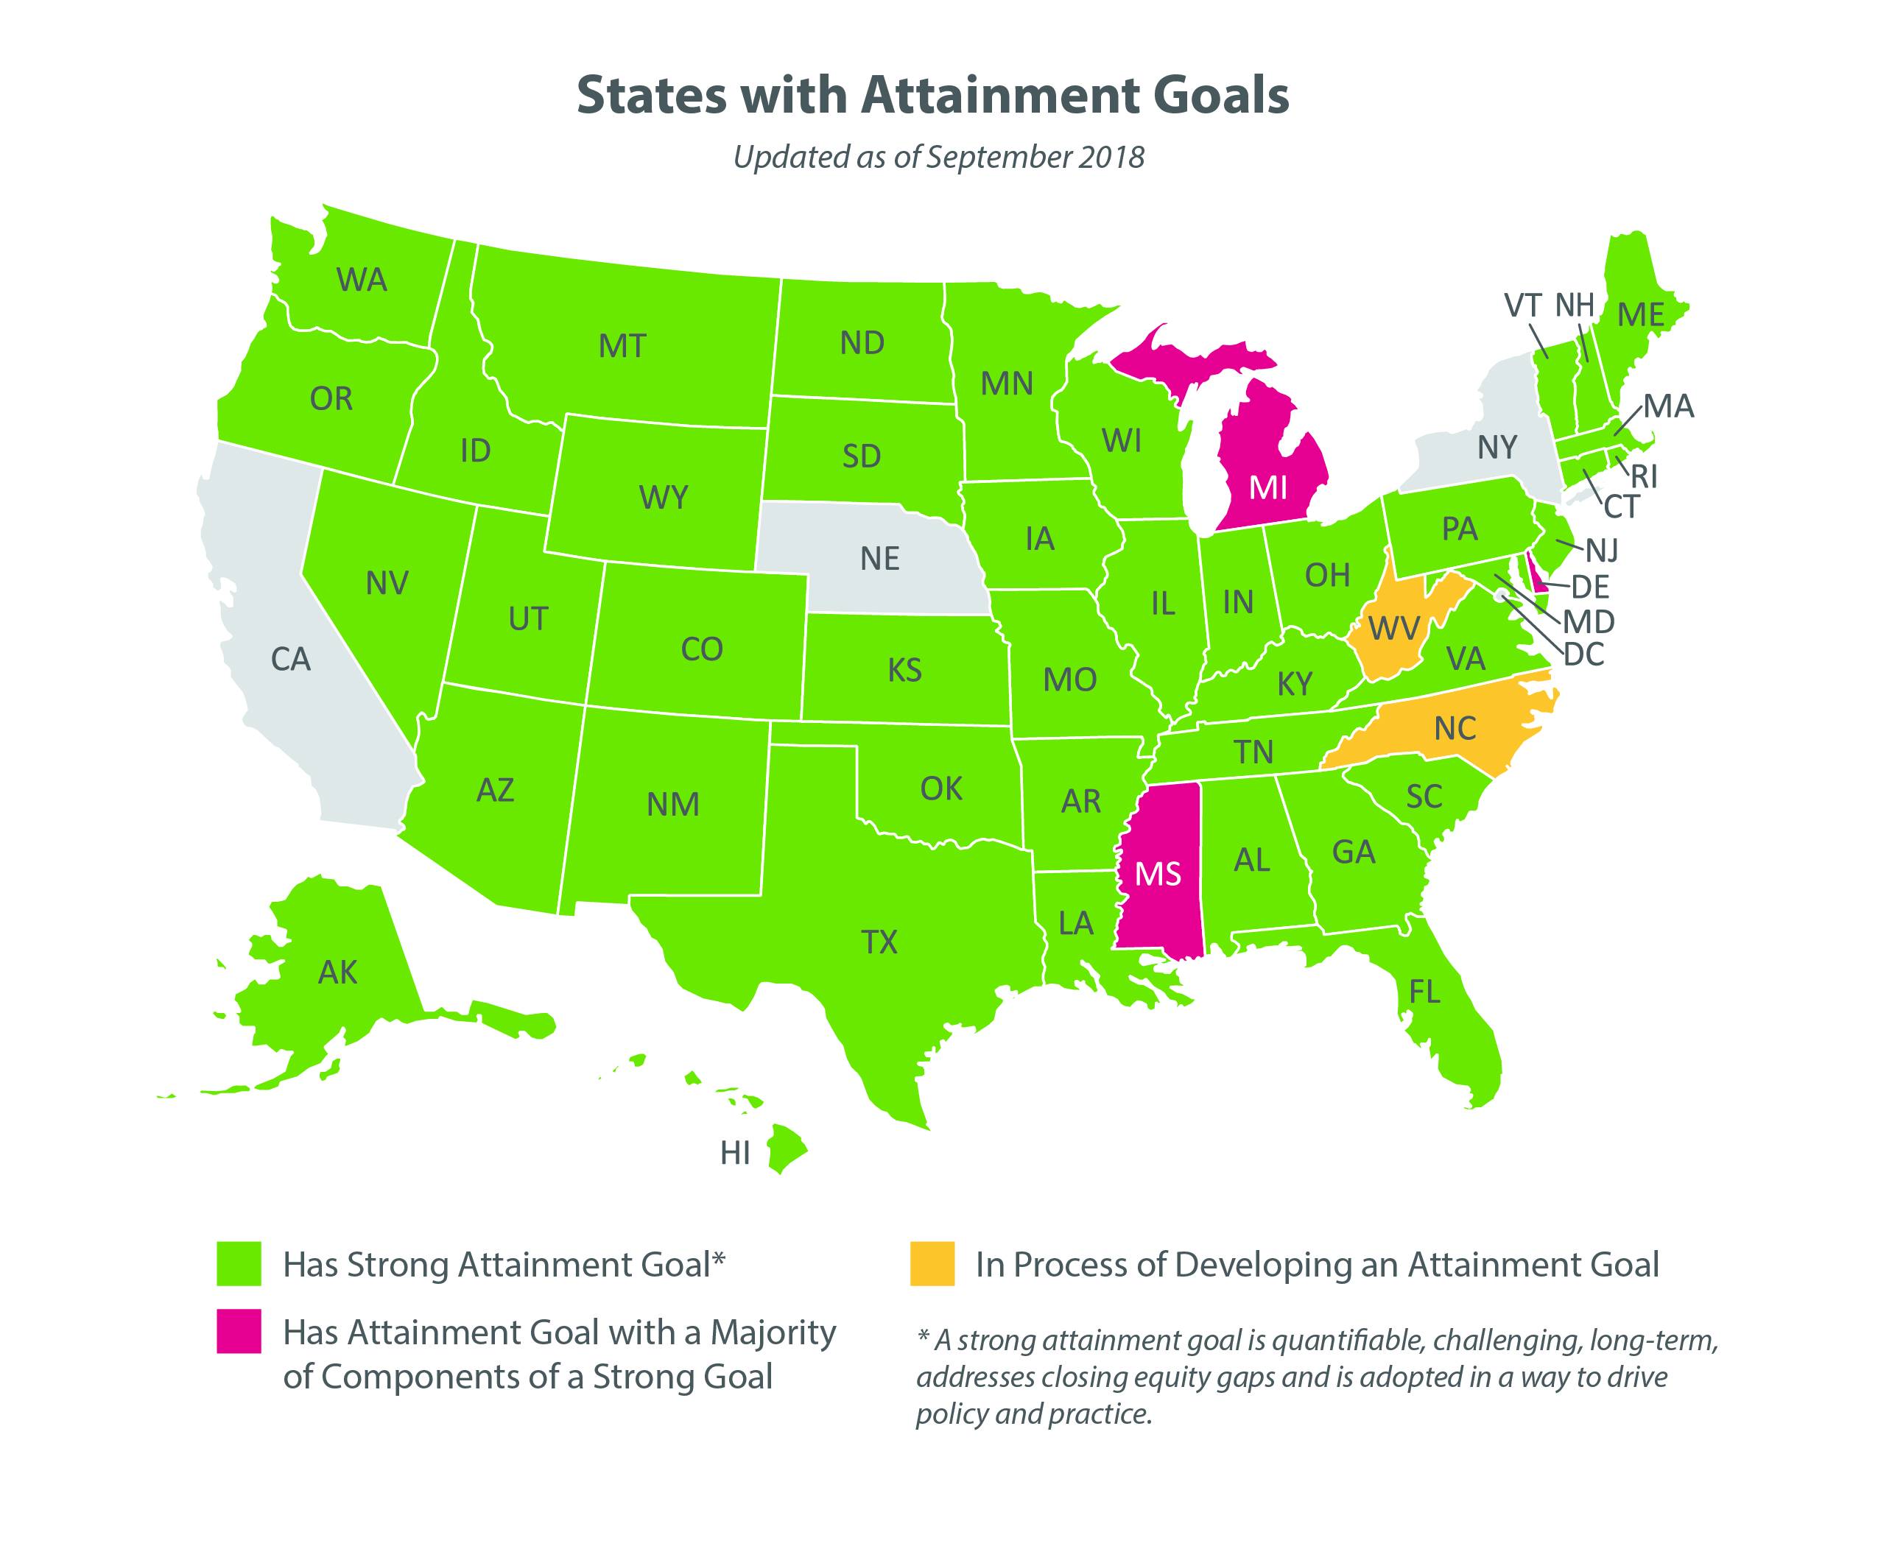

Slide 8
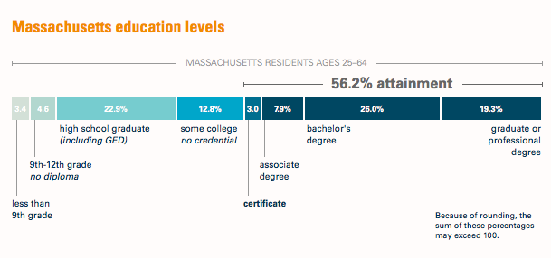

Slide 9
Focusing On Our Priorities
2019: Next Level? (One State-Level Goal)
2016: Big 3 Completion Plan (Three Goals)
2012: Vision Project (Seven Goals)

Slide 10
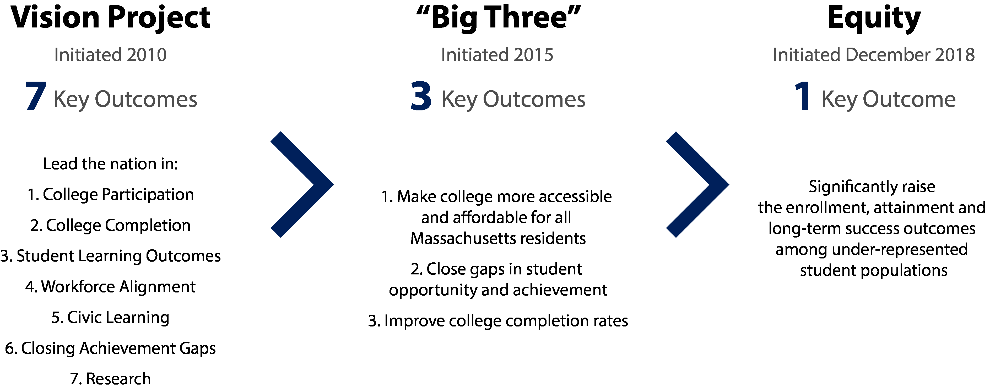
Narrowing the Focus

Slide 11
Why Equity?
Massachusetts leads in attainment: 56.2% of MA population has a high-quality certificate, associate degree or higher (Lumina Foundation)
Massachusetts lags in reducing achievement and opportunity gaps
Aligns with state values and needs

Slide 12
Equity Lens
Equity
College Enrollment
Workforce/Community Impact
Student Success

Slide 13
Three Reasons the Equity Lens as the Top Priority is the Right Choice:
The moral imperative
The economic imperative
The business model imperative (i.e. colleges need more enrollment)

Slide 14
Vision Statement
Equity Strategic Framework
The Massachusetts Board of Higher Education aims to sustain and expand on Massachusetts’ unique leadership position in higher education as defined by the strength and reputation of our private and public postsecondary institutions and our nation-leading level of attainment among our adult citizens.
To further realize those goals and to ensure that public higher education opens doors of opportunity and fulfilment for traditionally underserved populations…
We elect to make our top statewide policy and performance priority:
Significantly raise the enrollment, attainment and long-term success outcomes among
under-represented student populations.
We intend this equity lens priority to guide campus and system performance measurement and promote initiatives and policies that collectively expand success for residents and for our economy and society.

